Slide 1
Testing and Debugging
This may seem obvious, but who invented the catflap?

Slide 2
Some things seem obvious after the fact
But it is not always the case
You need to evidence that you can produce software of a professional quality
Therefore you need to evidence that you have carried out appropriate tests and demonstrate that your software is not full of bugs.
Notes:
Isaac Newton. Testing and debugging seems obvious but you’d be surprised at how badly it is done.

Slide 3
What is…
Testing?
Trying to
demonstrate that there are no defects in a program
continually reassuring yourself that defects have not crept into your program
Debugging?
finding and fixing defects
These should be evidenced.

Slide 4
Testing
You must demonstrate that you have tested your programs
The assumption is that your programs are defect free
they never will be but we must at least make them so few that they are not normally noticed
Defects cost $50 billion a year!

Slide 5
It can be expensive
Ariane V The most spectacular bug of all time.
Specifically a 64 bit floating point number relating to the horizontal velocity of the rocket with respect to the platform was converted to a 16 bit signed integer. The number was larger than 32,767, the largest integer storeable in a 16 bit signed integer, and thus the conversion failed.

Slide 6
Some buzz words
Unit Testing
Integration Testing
Regression Testing
We’ve made changes, does all the s/w still work correctly ?
Acceptance / System Testing
Does the s/w do what the user asked for?
Black box testing
White box testing

Slide 7
How to test
Black box testing
this is where someone else does it and looks at inputs and outputs
i.e. I did this and this happened, you fix it
i.e. the “box” is the program and it is opaque
White box testing
this is where you do it and look at the code
i.e. the “box” is transparent
It is often better to get someone else to test it in the end, but not before a programmer has tested it.

Slide 8
What is the purpose of Testing?
To uncover defects in the software
Testing does not include the tracking down of the bugs that caused the defects or the fixing of these bugs!
The earlier defects are detected, the easier & cheaper they are to fix.
Notes:
better fixed by the programmer than after it has been published

Slide 9
What’s different about testing OO software?
Object creation
Class – instance methods & the instance data they manipulate
Object interaction
Inheritance
Polymorphism.
Notes:
What to test.

Slide 10
A testing philosophy
Firstly, use iterative, incremental development
Analyze a little
Design a little
Code a little
Test what you can
Test early, test often, test enough.

Slide 11
What is a Test Case?
Defines the test’s purpose
Define the inputs to the test
Define the outputs (expected results) from the test
Document the actual results.

Slide 12
Unit Testing
The idea behind unit testing is simple
For each class you have a test class
the test class puts the current class through its paces and records the output
you say whether it was right (it should be) and it records inputs with outputs
you can now run the test class and if it fails it is something you’ve done since you last ran it
hence change little test often
Without this we might not even know that it had fallen over let alone that it was some change we have just made
It cannot be stressed enough just how valuable this is.
Notes:
Allows regression testing

Slide 13
Test Driven Development
Test Driven Development
This is an up and coming methodology
Design the tests BEFORE the software
Naturally all tests will fail
So make the software to pass the tests
Ensures a very focussed development
Keep within scope
Ensures development is focussed on producing code that will not have defects in
Hence avoids spiralling costs..

Slide 14
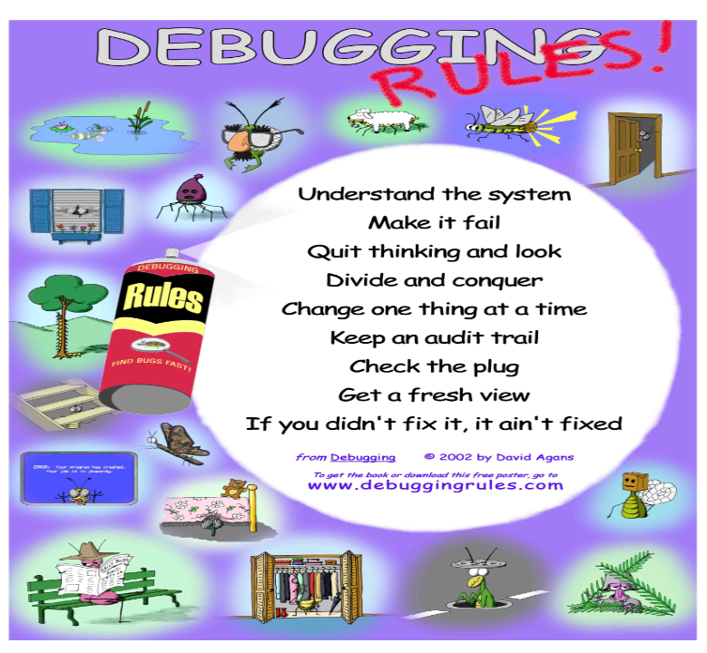

Slide 15
Dull fact
The term “bug” comes from “the first bug”
An early mainframe wasn’t working properly
Upon inspection a dead cockroach was found in its circuits
In honour of that poor roach all computer problems are named after it.

Slide 16
Debugging
If you are a programmer you are a debugger
What’s more you are more of a debugger than a programmer
probably anything from 50-90% debugging
So why do we spend so long lecturing on programming and almost nothing on debugging?

Slide 17
How to Debug
1 Locate Error
2 Design Error Repair
3 Repair Error
4 Retest
Defects in the code cause failures
Unfortunately not all defects cause failures
or not all of the time
intermittent faults are the hardest to locate or spot in the first place
Testing can only show the presence of errors not their absence
Debugging is relating a failure to a defect and removing the defect
most times this can remove lots of defects.

Slide 18
Why bugs occur
Not to be confused with syntax errors
Bugs are semantic errors, caused by
bad practice
incorrect use of tools (i.e. not using OO properly)
not using tools
messy code
I can’t understand it, you can’t understand it, they can’t understand it
mistakes
most typos will result in syntax errors but not all
> instead of <, certain semi colon errors etc.
misconceptions
not understanding how to code something
not understanding how the design works
inevitability
they will be there, it’s just how many.

Slide 19
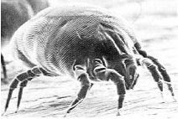
! A piece of software is a bit like a bed
You wouldn’t get into it if you could see the bugs
But will do if you can’t
all software has bugs (even mine)
but you must get rid of ALL the really visible ones
and not just visible to you, usually
professional programs are tested by professional testers
There is an amount of embarrassment in someone else finding your deficiencies

Slide 20
Bug Prevention
It’s much easier to stop flies coming into your house than spending hours splatting them
Prevention won’t stop them all but it will make life much easier
Rule 1 Use Appropriate Style
programs must look neat (tabbed)
must have appropriate comments and documentation for programs, classes, methods and sections of code
use appropriate names for classes, methods and variables
use constants and not numerical literals
Rule 2 Use Appropriate Techniques
remember each lecture is another tool
usually reduces the volume of code produced
therefore less places for bugs to hide
fix one fix all if there is no repeated code
Rule 3 Use Defensive Programming
make variables private, have access control
validate all inputs
don’t have to write code to cope with erroneous inputs.

Slide 21
Bug Prevention
Rule 4 Change little, test often
use unit testing facilities such a JUnit (Java) .net has it built in (C#)
Unit testing is about showing that your program has no errors
not finding them.

Slide 22
Fixing Bugs
You must be methodical
You must use a debugger
1 isolate the bug
at first you know it’s in your program
narrow it down to class, method, chunk, line – fix
You can do this quickly using output to the console
i.e. display a message “I’m in class xxx”, “I’m in method xxx and variable xpos = xxx”
you’ll then get
I’m in class xxx I’m in method xxx ‘@##@#crash##@##’
i.e. you have six messages in your program and you only see three then the bug resides between message 3 and 4
you can then put more messages in between
it’s a bit like being Sherlock Homes.

Slide 23
Using a Debugger
Get to know your debugger, it is your best friend
if your environment doesn’t have one you are using a toy
Your debugger can
single-step code line-by into or over methods
break at a set point with or without a condition
very useful if your bug is on the millionth time around a loop
inspect and change variables
Some debuggers have a profiler which creates a record of where your program has been
very useful for optimising your code
or finding the most likely places to look
Get used to your debugger..

